Slide 1

Creating a Heat Resilience Index for Property Evaluation
By (names removed for anonymity)

Slide 2
Background: Understanding Heat Stress
Heat stress occurs at temperatures of over 35°C
Can lead to impacts on productivity, sleep, health
England and Wales currently experience around 2,000 heat-related deaths annually, expected to rise to 7,000 by 2050 due to climate change (Leeds City Council, 2021)
During extreme heat periods, the Urban Heat Island (UHI) effect can cause urban temperatures to elevate above surrounding regions (Wolf and McGregor, 2013)
Properties need to be designed and retrofitted with heat resilience in mind – some properties are more at risk than others (Kovats and Hajat, 2008)

Slide 3
Objective and Approach
Our objective was to create a weighted matrix to determine the Heat Resilience Score of properties in Leeds. This would be used to refine which properties are at risk of heat stress when considering the individual property characteristics, as opposed to the whole area.
We explored the variables contained in the EPCertificates, deciding on those to be included in the Heat Resilience Index
We researched how each variable could affect the heat stress of a property and defined a scale for each
We then decided how significant each variable was on the overall heat stress of a property to determine the weightings for each within the overall index

Slide 4
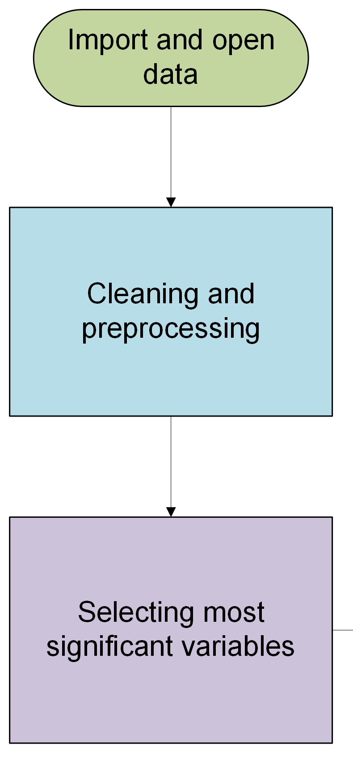
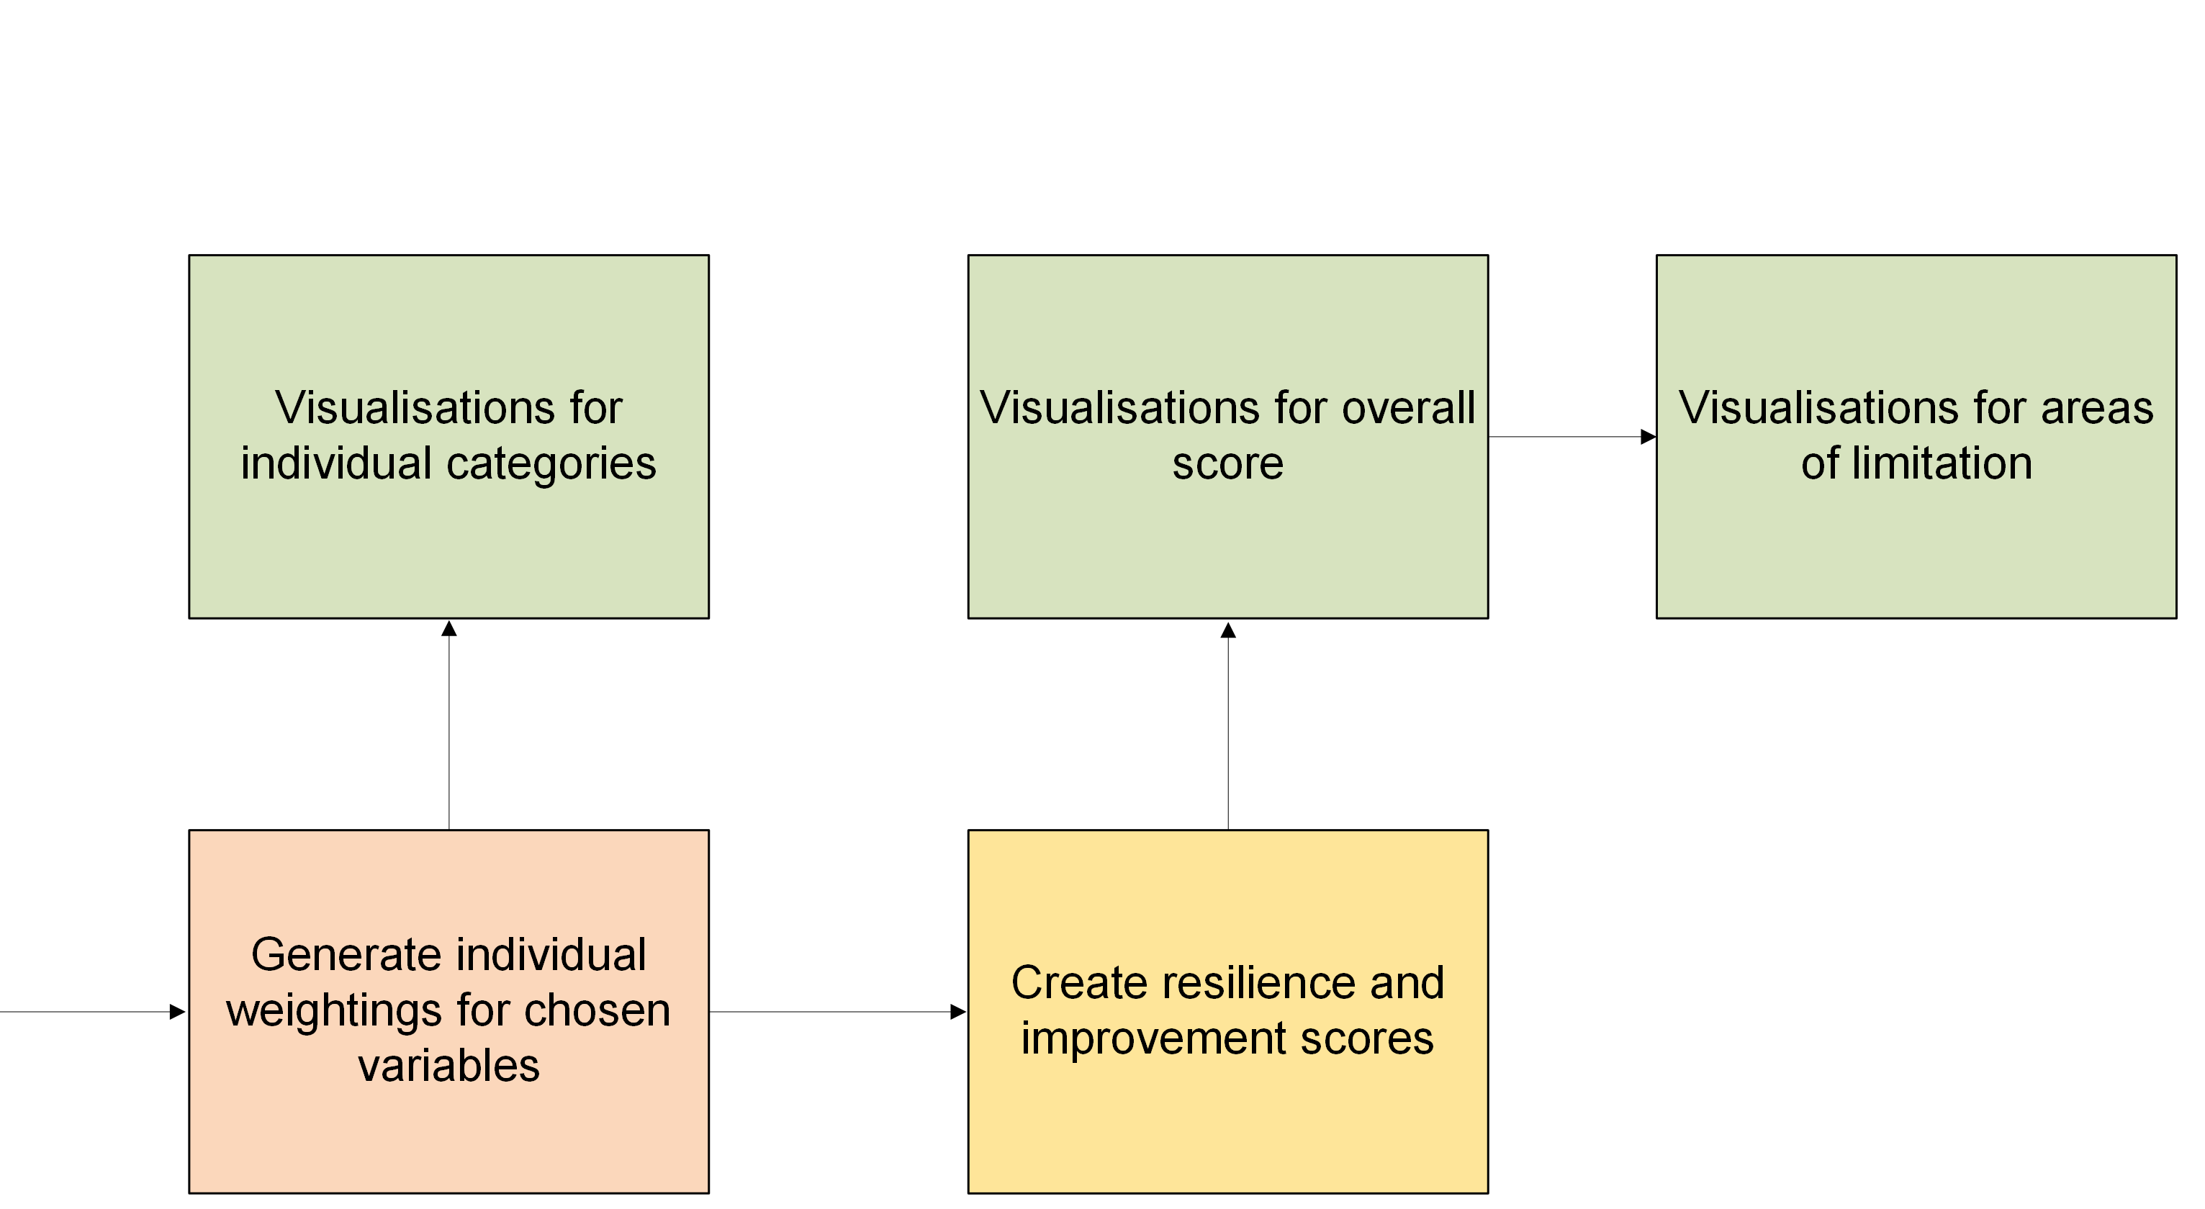
Methods
Notes:
For each variable deemed to contribute to heat stress we explored academic literature and government policy/ regulations to determine a scale for how each factor contributed to heat stress
Weight these scores into an overall property heat resilience index
Explain why we chose these variables
Explain why we chose these variables
Scoring heat resilience of property characteristics:

Slide 5

Data Description
Name | Description | Data Type | Source (URL)
Leeds EPC Data | Energy Performance Certificate data for buildings in Leeds | Comma Separated Values (.csv) | https://epc.opendatacommunities.org/#register
Leeds EPC Recommendations | Recommendations for improving energy performance | Comma Separated Values (.csv)
Leeds Heat Stress Data | Heat stress scores and categories by polygon in Leeds | Shapefile
OS Open UPRN | All UPRN values for properties in Great Britain, with latitude and longitude | Comma Separated Values (.csv) | https://www.ordnancesurvey.co.uk/products/os-open-uprn
Leeds Conservation Areas | Leeds conservation area boundaries | Shapefile | https://strategic-planning-leedscc.hub.arcgis.com/datasets/conservation-areas-3
Property type (House, Flat, Maisonette, etc.)
Building type (Detached, Semi-Detached, Terrace, etc.)
Construction date
Floor description (Insulation present or absent, average thermal transmittance score, floor type)
Walls description
Roof description (Average thermal transmittance score, thickness of insulation, presence of insulation)
Multi glaze proportion (total glazed area of the Property that is multiple glazed)
Glazed type (single, double, triple)
Total floor area
Flat top storey (Whether or not the flat is on the top storey)

Slide 6
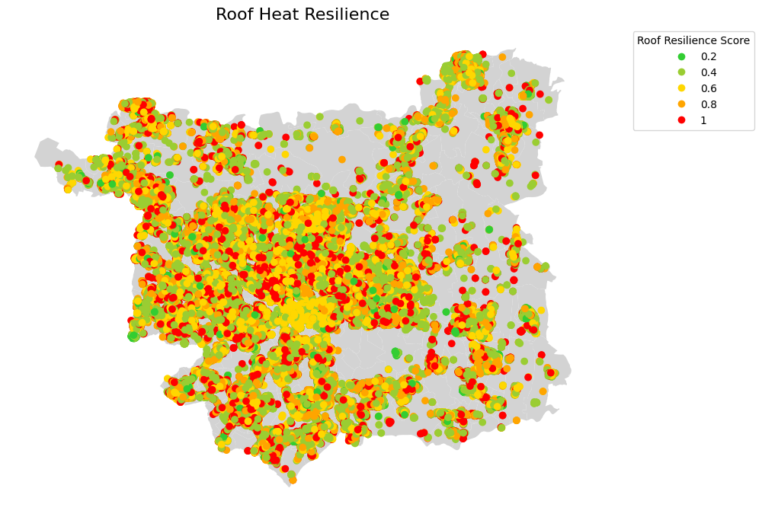
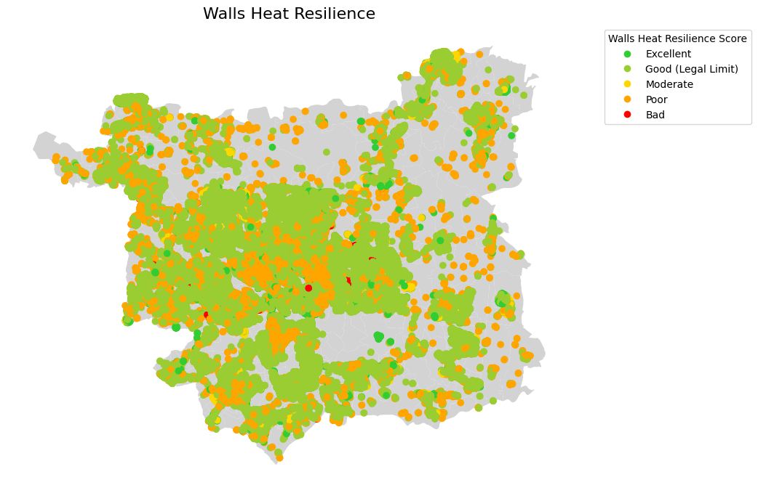
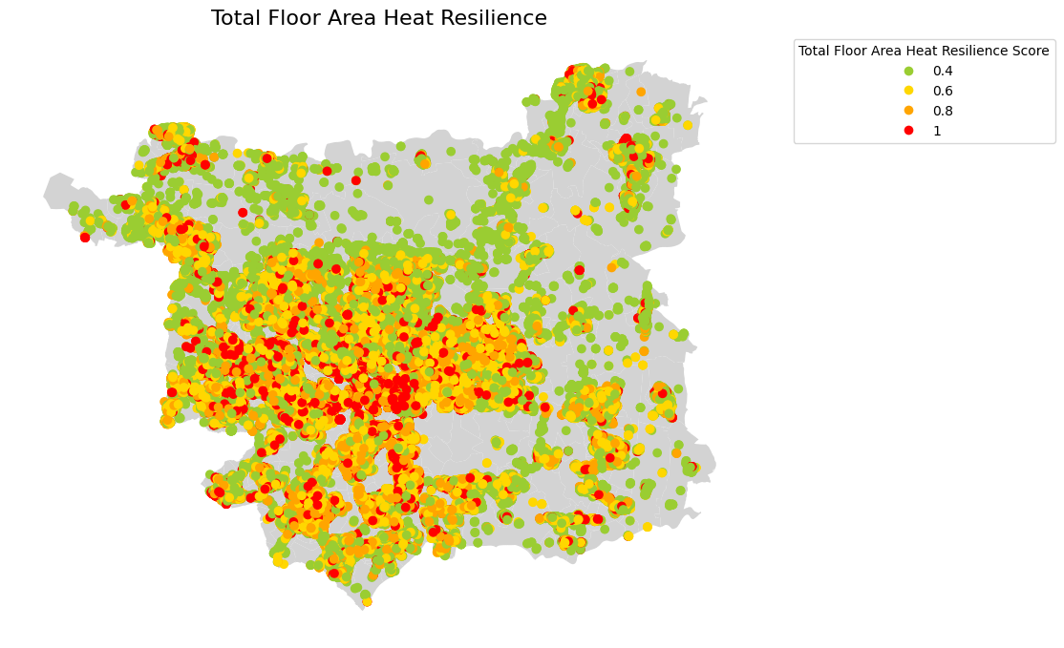
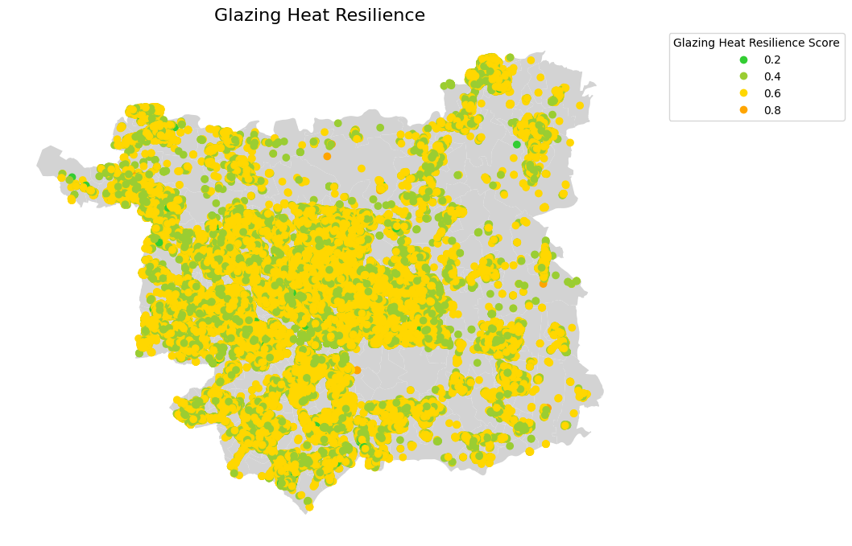
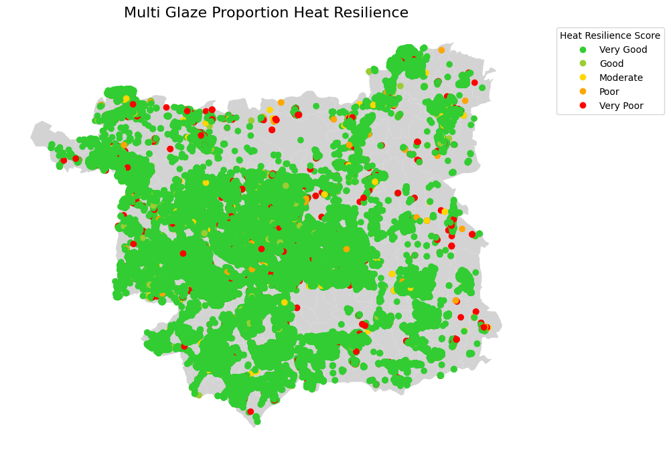
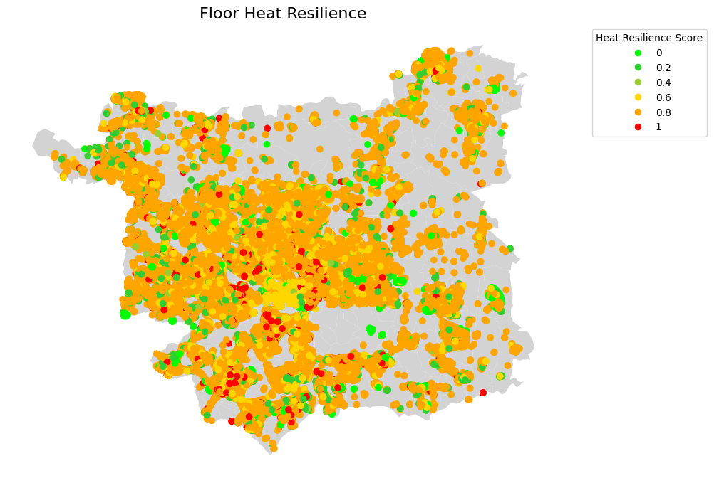
Visualizations: Property Characteristics Heat Resilience

Slide 7
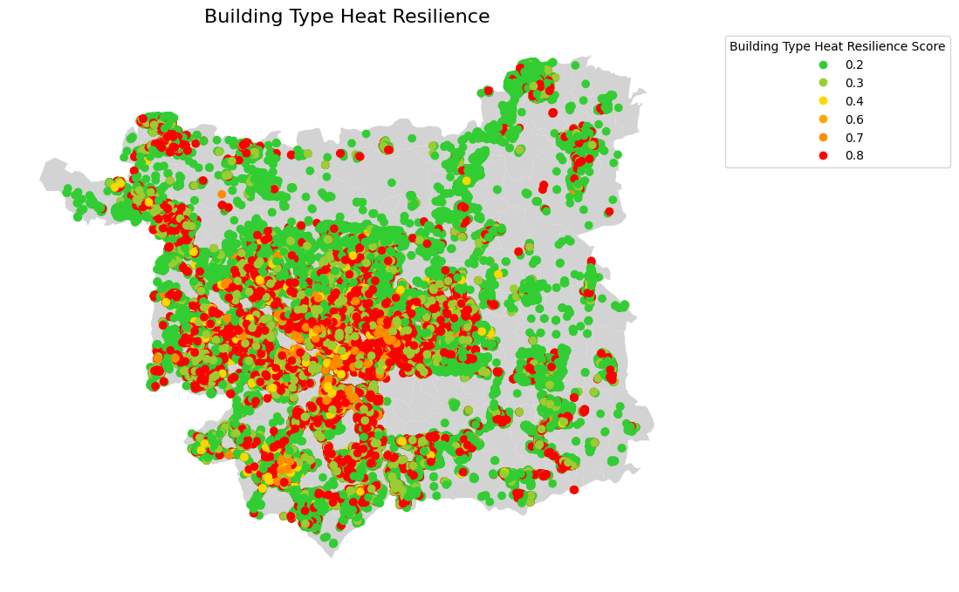
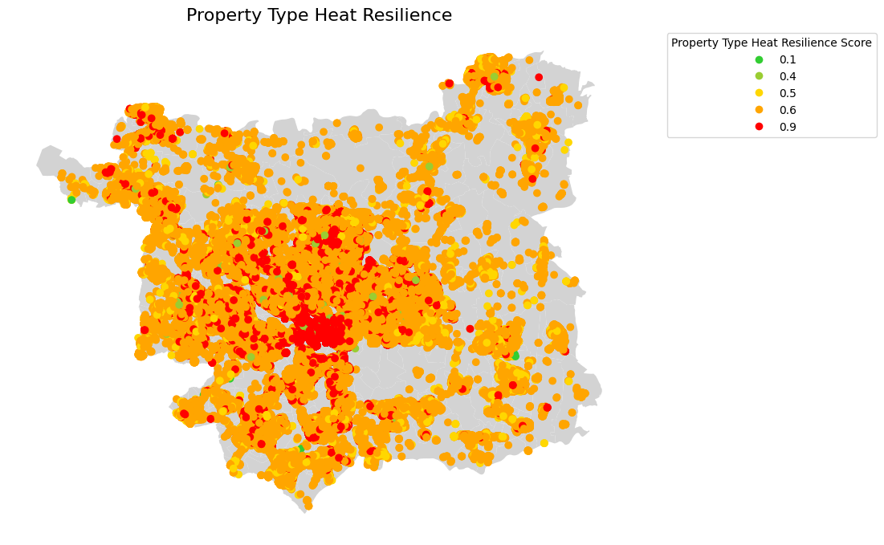
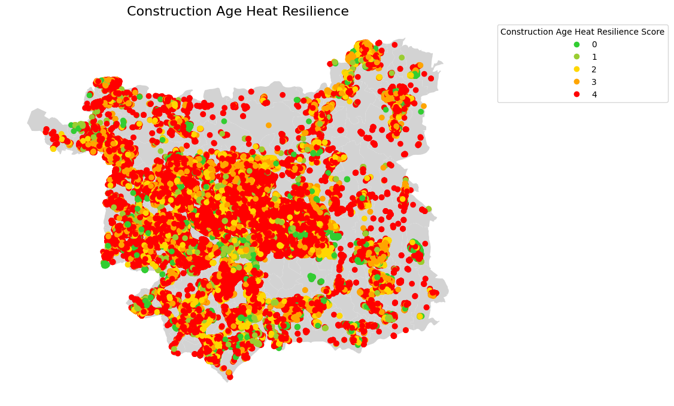
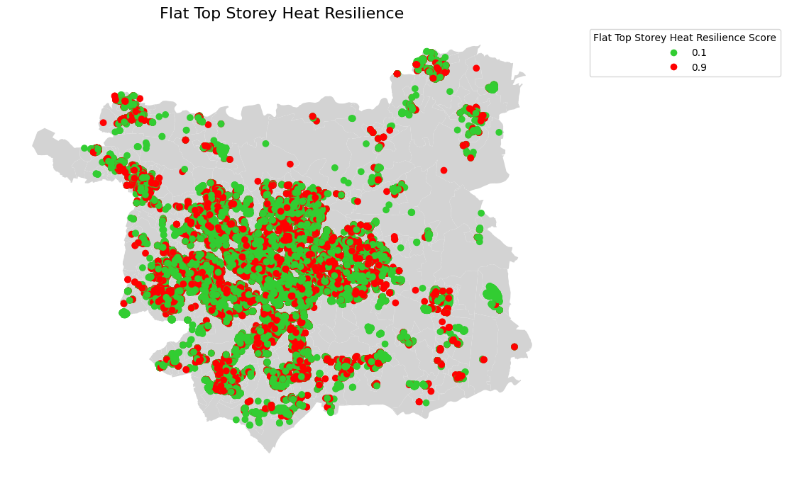
Visualizations: Property Characteristics Heat Resilience
General trend suggests that certain property types, older buildings, etc. contribute to bad resilience
Colors range from green (good resilience) to red (bad resilience)

Slide 8
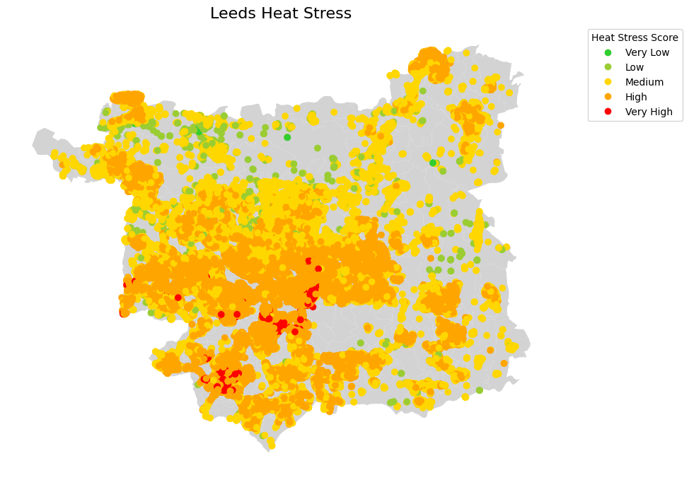
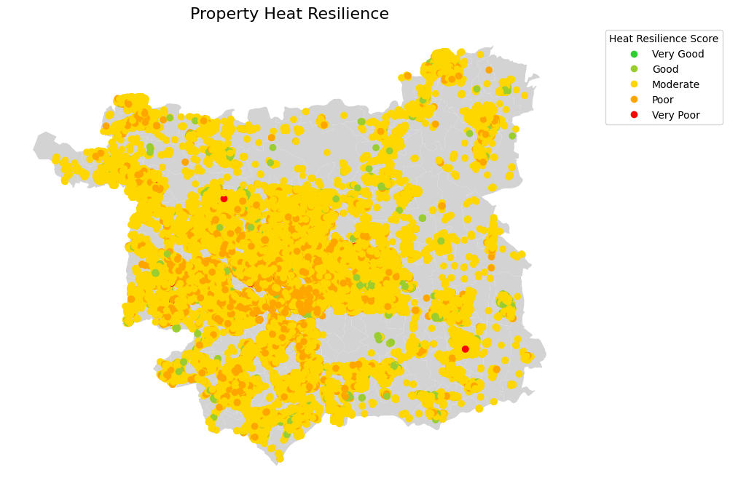
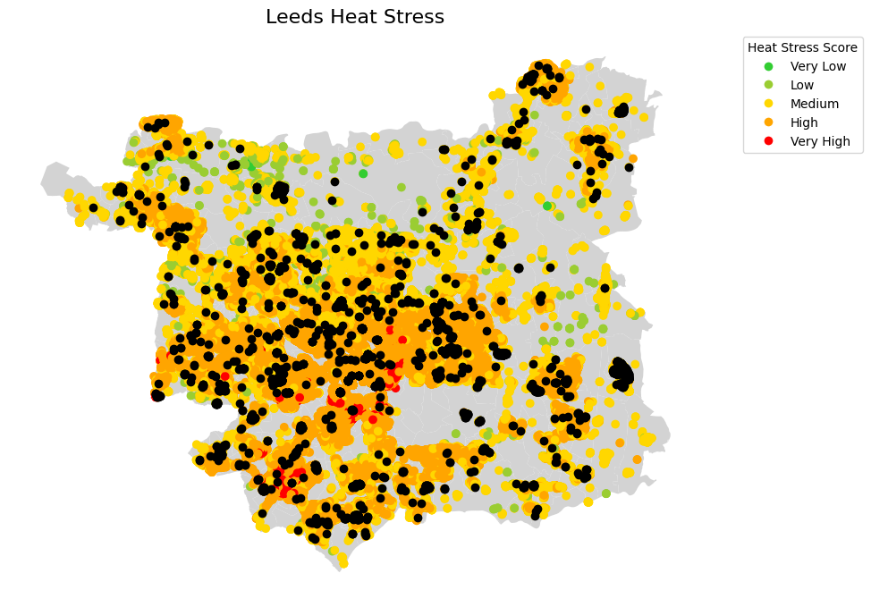
Heat Stress vs Property Heat Resilience Index
0.4% Very Poor Heat Resilience properties
28.3% Poor Heat Resilience properties
69.3% Moderate Heat Resilience properties
1.4% Good Heat Resilience properties
0% Very Good Heat Resilience properties
Good Heat Resilience properties (Black points)

Slide 9
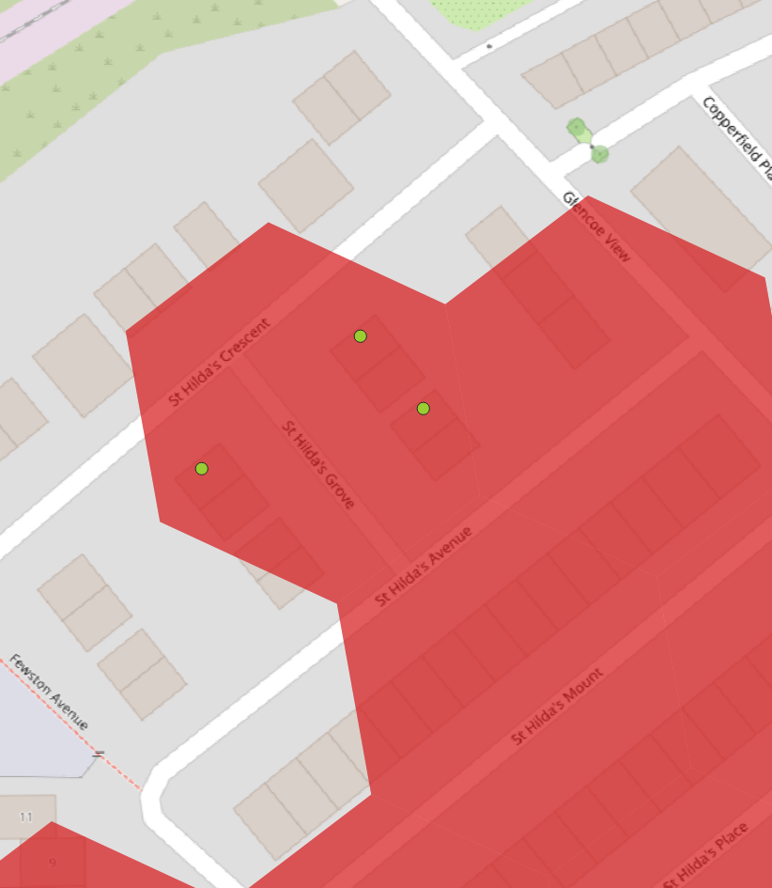
Analysis Report
1 St. Hildas Way
Property Type: House
Building Form: Semi-Detached
Area: 95m2
Property Age: 2012 onwards
Proportion of Windows Glazed: 100%
Windows: Double glazing installed during or after 2002
Flooring: Solid, insulated (assumed)
Walls: Cavity wall, as built, insulated (assumed)
Roof: Pitched, 400+ mm loft insulation
Heat Resilience Score: 0.397, Category: Good

Slide 10
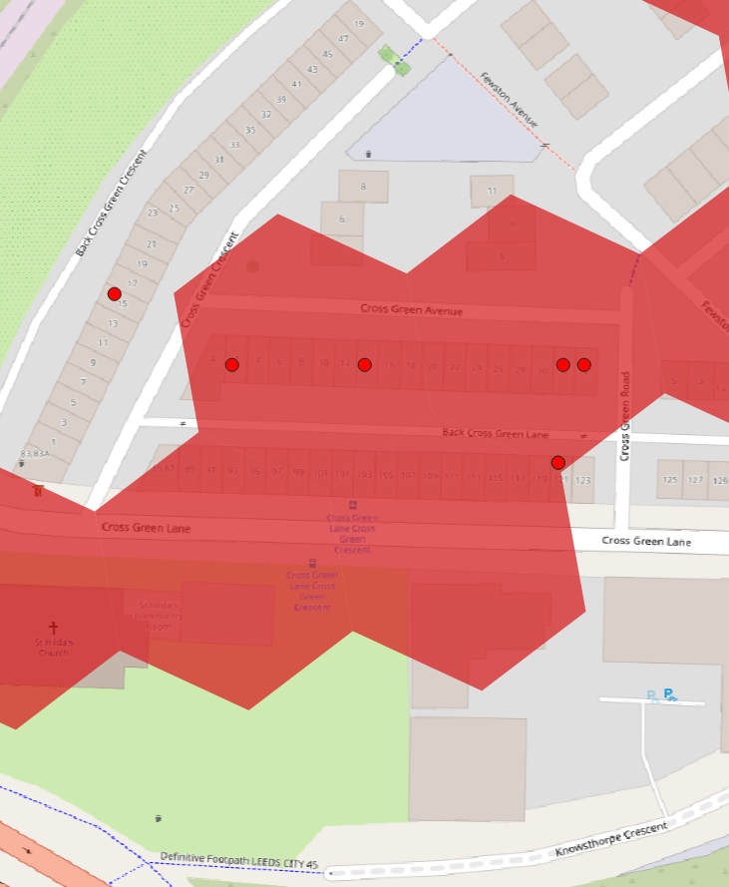
Improvement Index: Case Study
Flat 5, 14 Cross Green Avenue
Property Type: Flat
Building Form: Mid-Terrace
Area: 12m2
Top Floor: Yes
Property Age: before 1900
Proportion of Windows Glazed: 100%
Flooring: Another dwelling below
Windows: Double glazing installed before 2002
Walls: Solid brick, as built, no insulation (assumed)
Roof: Pitched, no insulation (assumed)
Heat Resilience Score: 0.88, Category: Very Poor

Slide 11
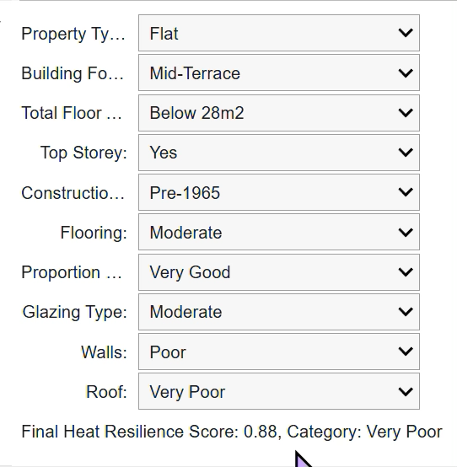
Improvement Index: Case Study
Flat 5, 14 Cross Green Avenue
Property Type: Flat
Building Form: Mid-Terrace
Area: 12m2
Top Floor: Yes
Property Age: before 1900
Proportion of Windows Glazed: 100
Flooring: Another dwelling below
Windows: Double glazing installed before 2002
Walls: Solid brick, as built, no insulation (assumed)
Roof: Pitched, no insulation (assumed)
Heat Resilience Score: 0.88, Category: Very Poor

Slide 12
Improvements/Solutions
Possible Improvements | Average Estimated Cost
Cavity Wall Insulation | £940.45
Draught Proofing | £100
Flat roof or sloping ceiling insulation | £1175
Floor insulation (suspended floor) | £1000
Floor insulation (solid floor) | £5000
Internal or external wall insulation | £9068.77
Party wall insulation | £450
Replace single glazed windows with low-E double glazed windows | £4854.24
Replacement glazing units | £1200
Room-in-roof insulation | £2100
Secondary glazing to single glazed windows | £1250

Slide 13
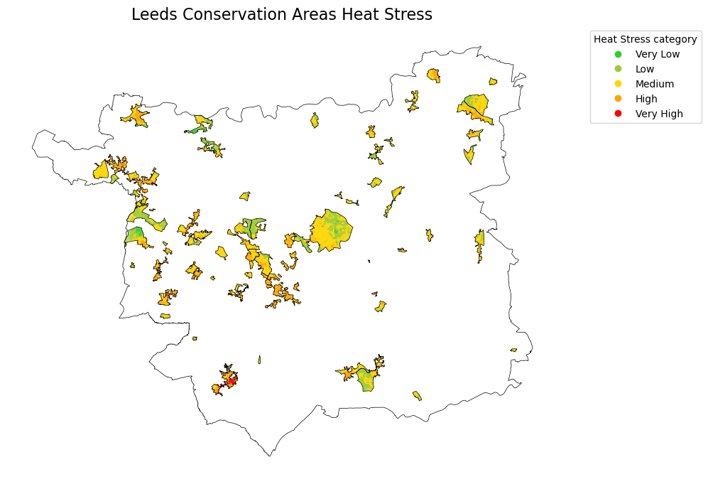
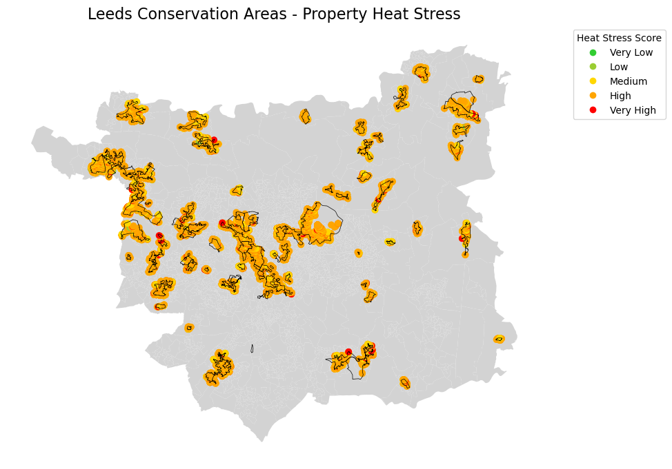
Limitations and Future Work
Ideally access to the dataset Energy Follow Up Survey (EFUS) with indoor temperature in summer & dwelling characteristics would have allowed us to calculate how each variable affects indoor temperature using a multivariate regression model to decide weighting for each variable, however this dataset was not publicly available
Availability of data for scoring each variable – comparison between differing metrics led to a more qualitative than quantitative process
In future work we would refine our matrix and weightings, with possibility of a differing scoring system for flats and housing
We also considered the Historic conservation areas within Leeds, as the improvements for these properties would need to be examined in further detail due to restrictions on how properties within these areas can be updated

Slide 14
References
Department for Energy Security and Net Zero. 2024. The effect of energy efficiency measures on summertime overheating in English homes: prevalence, frequency and intensity analysis. Overheating in Homes: Further Analysis of EFUS Data. Available at: https://assets.publishing.service.gov.uk/media/6723ab6cc3b359df505655a0/energy-follow-up-survey-prevalence-frequency-intensity-of-analysis.pdf
Kovats, R. S. and Hajat, S. 2008. Heat Stress and Public Health: A Critical Review. Annual Review of Public Health. [Online]. 29, pp. 41-55. [Accessed 22 February 2025]. Available from: https://www.annualreviews.org/content/journals/10.1146/annurev.publhealth.29.020907.090843
Leeds City Council. 2021.The Leeds Local Plan Update Scoping Consultation 2021. [Online]. [Accessed 22 February 2025]. Available from: https://www.leeds.gov.uk/planning/planning-policy/local-plan-update/carbon-reduction
Lomas, K.J., Watson, S., Allinson, S., Fateh, A., Beaumont, A., Allen, J., Foster, H., Garret, H. 2021. Dwelling and household characteristics' influence on reported and measured summertime overheating: a glimpse of a mild climate in the 2050's. Building and Environment. 107986. Available from: https://doi.org/10.1016/j.buildenv.2021.107986
Lomas, K.J., Li, M. 2023. An overheating criterion for bedrooms in temperate climates: Derivation and application. Built Services Engineering Research and Technology. 44(5). Available from: https://doi.org/10.1177/01436244231183113
UK Government. 2020. Insulating suspended timber floors: best practice. [Online]. [Accessed 23 February 2025]. Available from: https://www.gov.uk/government/publications/insulating-suspended-timber-floors-best-practice
UK Government. 2022. Solid floor insulation (SFI): best practice. [Online]. [Accessed 23 February 2025]. Available from: https://www.gov.uk/government/publications/solid-floor-insulation-sfi-best-practice
UK Government, 2023. The Building Regulations 2010, Document L: Conservation of Fuel and Power (Approved Document). Volume 1: Dwellings. 2021 edition incorporating 2023 amendments – for use in England. [Online]. [Accessed 24 February 2025]. Available from: https://assets.publishing.service.gov.uk/media/662a2e3e55e1582b6ca7e592/Approved_Document_L__Conservation_of_fuel_and_power__Volume_1_Dwellings__2021_edition_incorporating_2023_amendments.pdf
Wolf, T. and McGregor, G. 2013. The development of a heat wave vulnerability index for London, United Kingdom. Weather and Climate Extremes. [Online]. 1, pp. 59-68. [Accessed 23 February 2025]. Available from: https://doi.org/10.1016/j.wace.2013.07.004
Images: Free design tool: Presentations, video, social media | CANVA. No date. Available at: https://www.canva.com/ (Accessed: 11 February 2025).

Slide 15
Appendix
Heat Resilience Scoring Matrix:
Factor | Overall Weight (to be determined) | A | Score_A | B | Score_B | C | Score_C | D | Score_D | E | Score_E
PROPERTY_TYPE | 0.25 | Park home | 0.1 | Maisonette | 0.4 | Bungalow | 0.5 | House | 0.6 | Flat | 0.9
BUILT_FORM | 0.04 | Detached | 0.2 | End-Terrace | 0.3 | Enclosed End-Terrace | 0.4 | Semi-detached | 0.6 | Terrace | 0.8
TOTAL_FLOOR_AREA | 0.25 |  |  | Percentile 75 | 0.4 | Percentile 50 | 0.6 | Percentile 25 | 0.8 | Below Percentile 25 | 1
FLAT_TOP_STOREY | 0.15 | No | 0.1 | Yes | 0.9
MULTI_GLAZE_PROPORTION | 0.04 | 81+ | 0.2 | 61-80 | 0.4 | 41-60 | 0.6 | 21-40 | 0.8 | 0-20 | 1
GLAZED_TYPE | 0.04 | Very Good | 0.2 | Good | 0.4 | Moderate | 0.6 | Poor | 0.8
FLOOR_DESCRIPTION | 0.04 | Very Good | 0.2 | Good | 0.4 | Moderate | 0.6 | Poor | 0.8 | Very Poor | 1
WALLS_DESCRIPTION | 0.1 | Very Good | 0.2 | Good | 0.4 | Moderate | 0.6 | Poor | 0.8 | Very Poor | 1
ROOF_DESCRIPTION | 0.05 | Very Good | 0.2 | Good | 0.4 | Moderate | 0.6 | Poor | 0.8 | Very Poor | 1
CONSTRUCTION_AGE_BAND | 0.04 | 2011 onwards | 0.2 | 2004-2010 | 0.4 | 1985-2003 | 0.6 | 1966-1984 | 0.8 | Pre-1965 | 1

